Slide 1


Paul Webb
2024-05-22

Slide 2

Outline
Executive Summary
Introduction
Methodology
Results
Conclusion
Appendix

Slide 3
Executive Summary
Summary of methodologies
Data Collection was performed both via an API and Web scraping techniques
Data Wrangling was performed to standardize data and replace missing values
Exploratory Data Analysis using SQL queries was performed (SQLite)
Exploratory Data Analysis via Visualization was performed (Seaborn)
Visualization via interactive maps marking key data was performed (Folium)
An interactive dashboard was created to explore data (Plotly Dash)
Summary of all results
Landing sites should be place near coastlines and the equator
Kennedy Space Center (KSC LC-39A) launch site offers the highest chance of a successful first stage recovery
The highest chance of a first stage recovery success are for ES-L1, GEO, HEO and SSO orbits
Success rates increase with the flight number (time/experience)

Slide 4
Introduction
Project background and context
Commercial space launch providers have been entering the market and ramping up launch capabilities over the past 2-3 decades. One of the most successful is SpaceX who have reduced launch costs by focusing on reusability.
The aim of this project is to use machine learning and visualization techniques to predict the probability of a successful first stage landing. Successfully landing the first stage provides the ability to reuse and to reduce the overall launch cost. This will provide data for the business case for an alternate entrant into the commercial space launch sector.
Problems you want to find answers
What factors determine the successful landing and reuse of the first stage of a launch?
Provide dashboards and visualizations to allow exploration of launch data
Provide a predictive model of successful first stage recovery based on relevant factors

Slide 5

Section 1

Slide 6
Methodology
Executive Summary
Data collection methodology:
Publicly available launch data was collected
Data was collected through a combination of API calls to SpaceX and web-scraping of Wikipedia pages
Perform data wrangling
Data retrieved was converted to Pandas data frames
Data was filtered as appropriate (Falcon9 launch data only)
Data was explored and additional columns created as required to assist with analysis

Slide 7
Methodology
Executive Summary
Perform exploratory data analysis (EDA) using visualization and SQL
Visualizations of key features and their relationships were created using the Seaborn library
Data was loaded into an SQLite database for exploratory analysis of locations, payloads, launch sites and how each affect first stage recovery
Perform interactive visual analytics using Folium and Plotly Dash
Folium was used to generate interactive maps exploring launch sites and nearby facilities
A Plotly Dash application was created to explore successful launches by site, payload mass and booster version

Slide 8
Methodology
Executive Summary
Perform predictive analysis using classification models
Data related to launch and recovery attempts were loaded
Data were split into test and train data sets
Alternative prediction models were trained and evaluated:
Logistic Regression
Support Vector Machine
Decision Tree
K Nearest Neighbors
The alternatives were scored and the most accurate was chosen

Slide 9
Data Collection
How data sets were collected:
Data sets were collected using a combination of SpaceX API access and web-scraping techniques
The “requests” library was used to retrieve the data in both cases
API data was read in JSON format and converted to Pandas dataframes
Web data was processed with “BeautifulSoup” to extract relevant data to load into Pandas
The following slides detail the collection process with flow charts and further details about the location of the collected data

Slide 10
Data Collection – SpaceX API
Standard REST GET calls to the SpaceX API endpoints were made using the “requests” library to retrieve JSON data
The JSON data was processed and converted into Pandas Dataframes
Dataframes were filtered to only include Falcon 9 Launches
Resulting data was persisted as CSV for further processing in later stages
Jupyter notebook detailing processing and endpoints used is available from: https://github.com/technobok/ibm_data_science_professional_certificate/blob/main/applied_datascience_capstone(10)/module1/1%20Collecting%20the%20Data/jupyter-labs-spacex-data-collection-api.ipynb
Request Data from API endpoint
Process JSON response
Convert to Pandas Dataframe
Filter Dataframe as required
Persist data to CSV

Slide 11
Data Collection – Scraping
“requests” was used to retrieve data from Wikipedia detailing the launch details of SpaceX launches
Retrieved HTML data was processes with “BeautifulSoup”
The correct HTML table was selected
Columns of relevant data were built by iterating through the table
The dictionary of columns was converted to a Pandas Dataframe
Jupyter notebook detailing processing and URL’s used is available from: https://github.com/technobok/ibm_data_science_professional_certificate/blob/main/applied_datascience_capstone(10)/module1/1%20Collecting%20the%20Data/jupyter-labs-webscraping.ipynb
Retrieve Wikipedia data
Process HTML with “BeautifulSoup”
Target correct HTML table and data
Build data columns of relevant data
Create a Pandas Dataframe

Slide 12
Data Wrangling
Previously retrieved CSV data was loaded
Fields with missing data were identified
Numerical vs Categorical fields were identified
Types of unsuccessful first stage landings with identified
A simplified “Outcome” column was created showing success/failure of first stage recovery
Jupyter notebook detailing the data wrangling steps is available at: https://github.com/technobok/ibm_data_science_professional_certificate/blob/main/applied_datascience_capstone(10)/module1/2%20Data%20Wrangling/labs-jupyter-spacex-Data%20wrangling.ipynb
Retrieve CSV data as Pandas Dataframe
Explore data using isnull, dtypes, value_counts etc.
Identify unsuccessful first stage landing types
Build a new “Outcomes” column as a list
Add “Outcomes” columns to the Pandas Dataframe
Persist data to CSV

Slide 13
EDA with Data Visualization
The Seaborn visualization library was used to create plots
Key features that were expected to be related to successful first stage recovery were:
Flight number
Payload mass
Launch site
To visualize, the following plots of these features were created:
Payload mass per Flight number, colored by success of first stage recovery
Launch site per Flight number, colored by success of first stage recovery
Launch site per Payload mass, colored by success of first stage recovery
Orbit type per Flight number, colored by success of first stage recovery

Slide 14
EDA with Data Visualization
The Jupyter notebook detailing visualizations created is available at:
https://github.com/technobok/ibm_data_science_professional_certificate/blob/main/applied_datascience_capstone(10)/module2/2%20Exploratory%20Analysis%20Using%20Pandas%20and%20Matplotlib%20(Visualisation)/edadataviz.ipynb

Slide 15
EDA with SQL
Launch data was loaded into an SQLite database for exploration
The following queries were run:
Listing of distinct Launch Sites
Listing of launches from sites beginning with CCA
Aggregate sum of mass launched for a customer (NASA)
Average payload for the F9 v1.1 rocket
Date of the first successful ground landing
Names of booster versions successfully landing on a drone ship with payload mass between 4000 and 6000 KG.
Total number of missions grouped by mission outcome (success, failure)

Slide 16
EDA with SQL
The following queries were run (continued):
List of booster versions that have carried a mass equal to the maximum payload mass
List of records, with month names, that failed landing on drone ships within 2015
Ranked summary of number of missions for each landing outcome type
The Jupyter notebook containing the database created and the SQL queries run is available at: https://github.com/technobok/ibm_data_science_professional_certificate/blob/main/applied_datascience_capstone(10)/module2/1%20Exploratory%20Data%20Analysis%20Using%20SQL/jupyter-labs-eda-sql-coursera_sqllite.ipynb

Slide 17
Build an Interactive Map with Folium
Folium was used to generate interactive maps showing:
Locations of launch attempts
Locations annotated with number of launch attempts and with success/failure markers
Markers show distance and lines to nearby facilities: Nearest Coastline, Nearest city, Nearest Railway line, Nearest Highway
These markers were added to determine the factors used for a launch site: location for rocket trajectories, local available facilities etc.
The Jupyter notebook containing the Folium maps generated is available at: https://github.com/technobok/ibm_data_science_professional_certificate/blob/main/applied_datascience_capstone(10)/module3/1%20Interactive%20Visual%20Analytics%20and%20Dashboard%20(Folium%2BPlotly)/lab_jupyter_launch_site_location.ipynb

Slide 18
Build a Dashboard with Plotly Dash
Plots/graphs and interactions you have added to a dashboard:
A Plotly Dash application was built to explore the relationships between launch site, payload mass and booster version and how they relate to successful first stage recovery
Graphs added to the application were:
Pie chart of distribution of total successful launches by site…
…with drill down to see total launches for a site by success/failure
Scatter chart of Success/Failure by Payload mass, colored by booster version
Interactions added were:
A dropdown list to select launch site, with an option for ‘All’ to visualize all launches from any site
A payload range selector to explore the first stage recovery as related to ranges of payload mass
The source code for the Plotly Dash application can be found at: https://github.com/technobok/ibm_data_science_professional_certificate/blob/main/applied_datascience_capstone(10)/module3/1%20Interactive%20Visual%20Analytics%20and%20Dashboard%20(Folium%2BPlotly)/spacex_dash_app.py

Slide 19
Predictive Analysis (Classification)
A machine learning pipeline was created to predict the successful landing and reuse of the first stage
The features were standardized using the StandardScaler
The independent and dependent features were isolated
The dataset was split into training and testing sets
Several predictive methods were evaluated (Logistic Regression, Support Vector Machine, Decision Tree classifier, K Nearest Neighbours)
For each method, Grid Search was used to determine the best parameters on the ‘train’ data
The result of each method was evaluated on the ‘test’ data using its score() and a confusion matrix
The best performing model was chosen
The Jupyter notebook detailing the predictive analysis models tested is available at: https://github.com/technobok/ibm_data_science_professional_certificate/blob/main/applied_datascience_capstone(10)/module4/1%20Predictive%20Analysis%20(Classification)/SpaceX_Machine%20Learning%20Prediction_Part_5.ipynb
Standardize dataframe features
Split independent (X) and dependent (Y) features
Split data into ‘test’ and ‘train’ sets
Per model, use GridSearch to find best parameters
Per model, evaluate using score() + confusion matrix
Select best performing model

Slide 20
Results
Exploratory data analysis results
The 4 launch sites used by SpaceX were determined
The total payload mass delivered for NASA is approaching 100 metric tons
The first successful ground pad landing was December 2015
There are 4 versions of Falcon 9 boosters that have delivered payloads from 4,000 to 6,000 kg
There were 2 failed drone ship attempted landings in 2015
The percentage of successful first stage landings are increasing over time
The chance of a successful first stage landing increases with payload mass

Slide 21
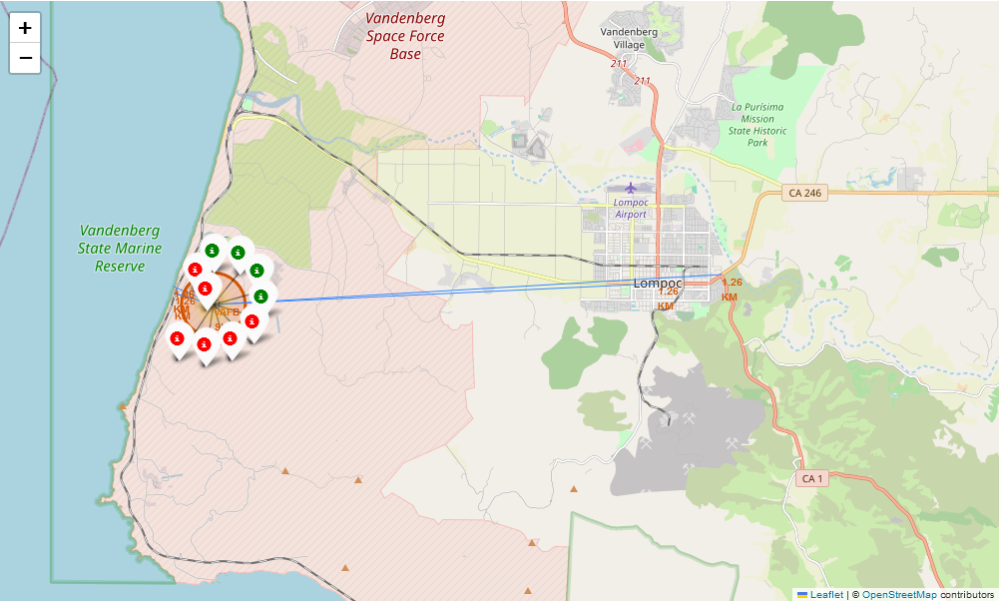
Results
Interactive analytics demo in screenshots:
Demo screenshot of interactive Folium map generated showing number of successful/failed first stage recoveries launched from Vandenberg AFB, with markers to nearest facilities (coastline, rail line, city, highway)

Slide 22
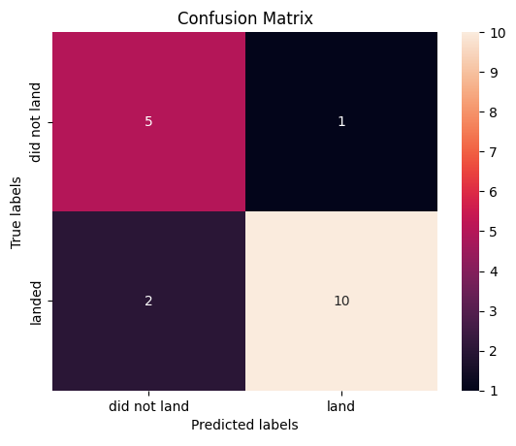
Results
Predictive analysis results
Decision Tree performed the best of the predictive models based on its scores in both the training and test data sets
A Confusion matrix on the training data is presented

Slide 23

Section 2

Slide 24
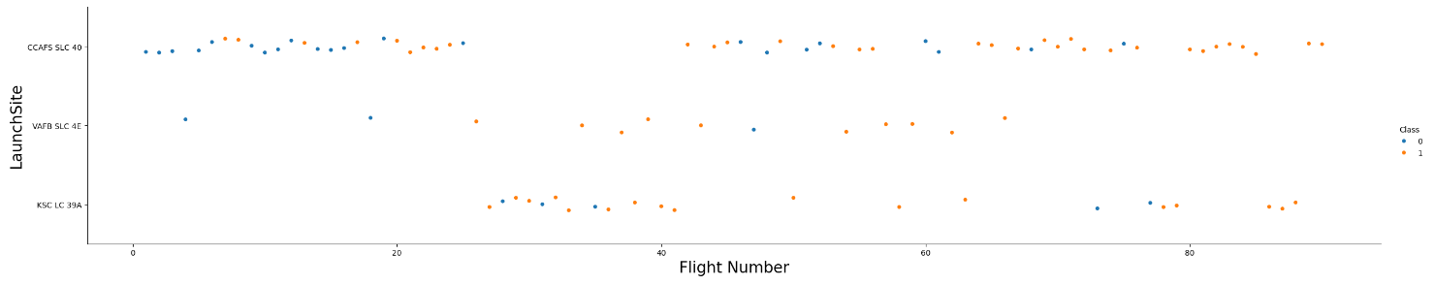
Flight Number vs. Launch Site
A scatter plot of Flight Number vs. Launch Site
Reliability of first stage recovery has increased at all launch sites over time

Slide 25
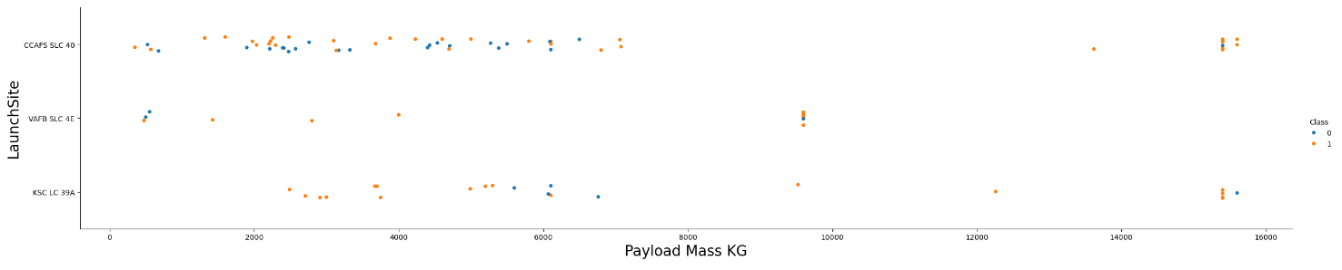
Payload vs. Launch Site
A scatter plot of Payload vs. Launch Site
VAFB launch site does not host missions with a payload mass over 10,000kg
There are only 2 missions with over 10,000 kg payload where the first stage was not recovered

Slide 26
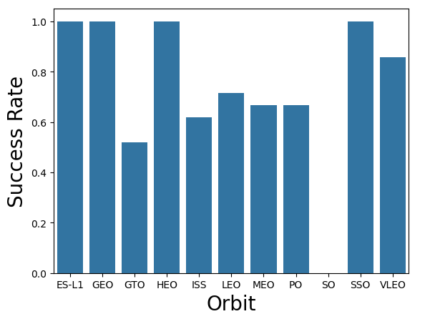
Success Rate vs. Orbit Type
A bar chart for the success rate of each orbit type is presented
There is a 100% first stage recovery success rate for ES-L1, GEO, HEO and SSO orbits

Slide 27
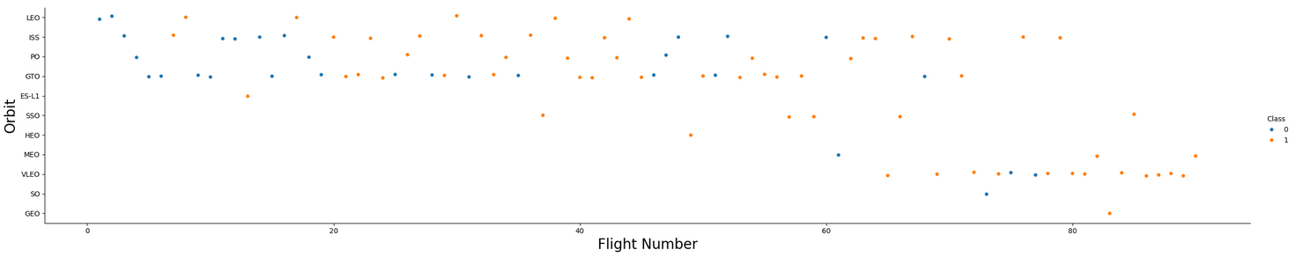
Flight Number vs. Orbit Type
A scatter plot of Flight number vs. Orbit type
Chance of first stage recovery is increasing for all orbit types over time (flight number)
Recently there are fewer GTO missions instead VLEO missions are increasing

Slide 28
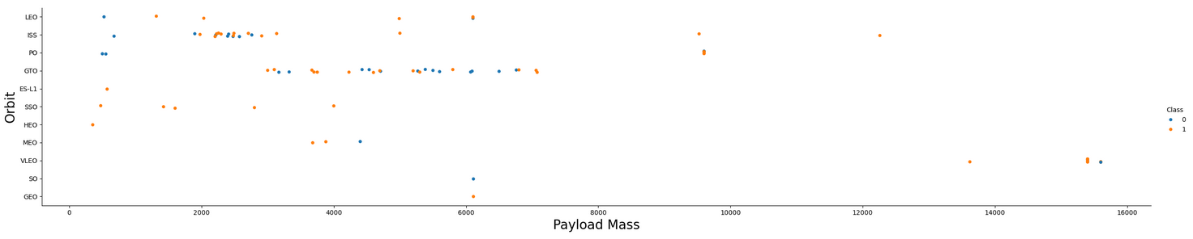
Payload vs. Orbit Type
A scatter point of payload vs. orbit type
Higher payload masses (over 8,000 kg) are only launched to ISS, PO and VLEO orbits and these appear to have a higher success rate of recovering the first stage

Slide 29
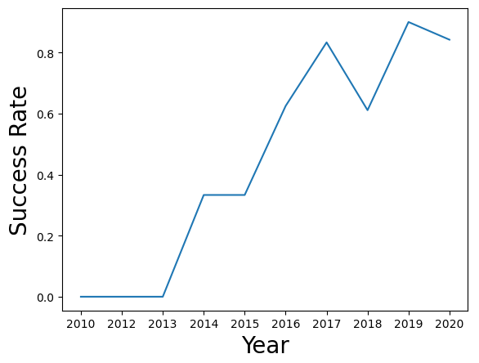
Launch Success Yearly Trend
A line chart of yearly average success rate
We observe a clear upward trend for the success of first stage recovery over time since 2013 to the present

Slide 30
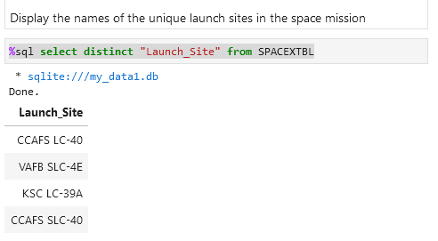
All Launch Site Names
A list of unique launch sites are presented
‘select distinct’ was used to create the list

Slide 31
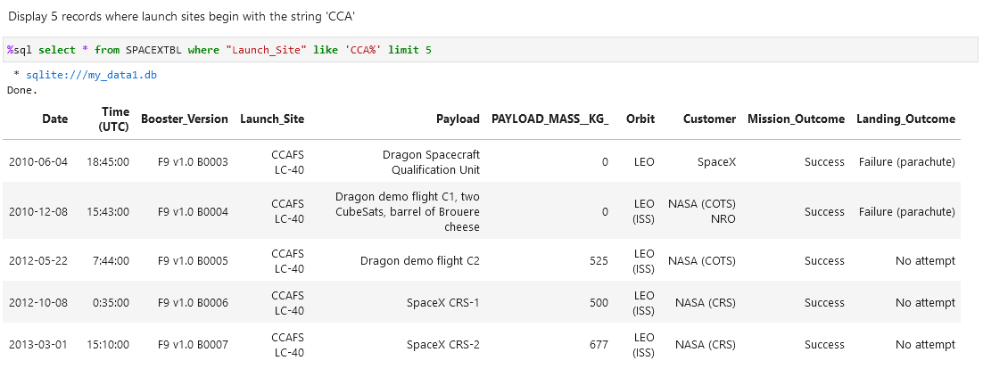
Launch Site Names Begin with 'CCA'
Listing of 5 records where launch sites begin with `CCA` is presented
The ‘like’ operator using a pattern with the ‘%’ wildcard character matched the correct records
‘limit’ was used to return a maximum of 5 records only

Slide 32
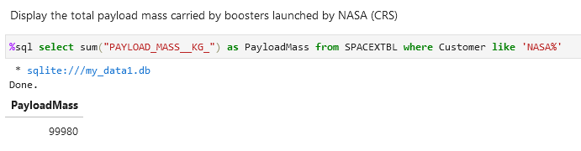
Total Payload Mass
Calculation for the total payload carried by boosters from NASA is presented
The aggregate ‘sum’ function was used to total payload mass for all matching records
The ‘like’ operator was used to match NASA launches

Slide 33
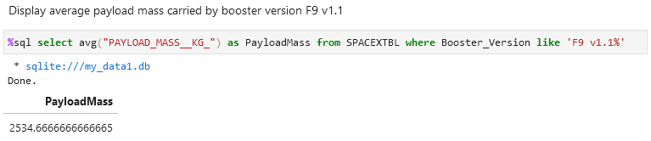
Average Payload Mass by F9 v1.1
Calculation the average payload mass carried by booster version F9 v1.1 is presented
The ‘avg’ aggregate function was used to calculate the average payload mass for the matching records

Slide 34
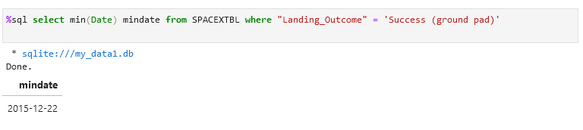
First Successful Ground Landing Date
The date of the first successful landing outcome on ground pad was determined
The aggregate ‘min’ function was used to find the earliest date of the matching successful ground pad records

Slide 35
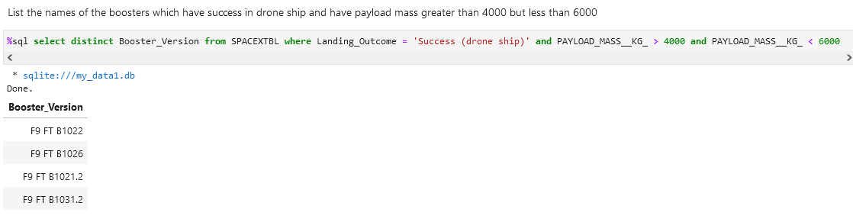
Successful Drone Ship Landing with 4,000-6,000kg Payload
A list of the names of boosters which have successfully landed on drone ship and had payload mass greater than 4,000 but less than 6,000 kg is presented
Multiple expressions in the ‘where’ clause were used to apply the criteria
‘distinct’ is used to show unique Booster versions

Slide 36
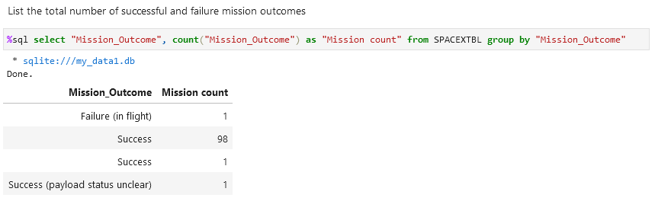
Total Number of Successful and Failure Mission Outcomes
A calculation the total number of successful and failure mission outcomes is presented
‘group by’ was used to aggregate the result set by Mission_Outcome
The mission outcome itself was listed followed by a column showing the ‘count’ of that mission type

Slide 37
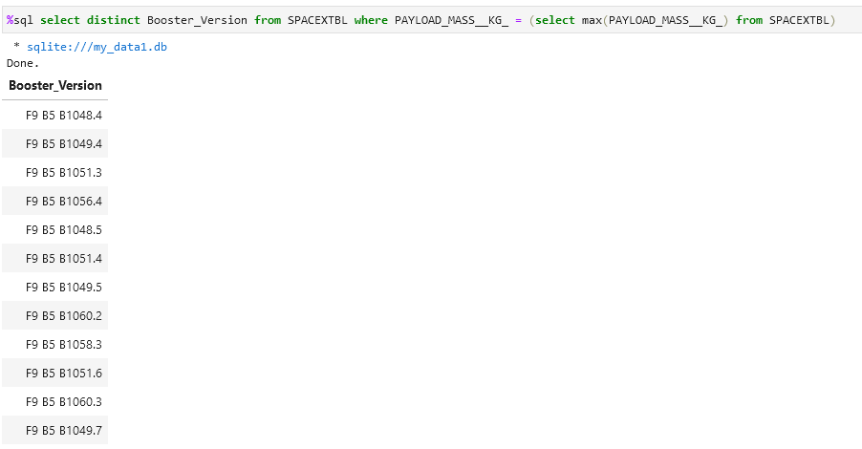
Boosters Carried Maximum Payload
A list of the names of boosters which have carried the maximum payload mass is presented
A subquery was used to determine the maximum payload mass
The ‘where’ clause selects all missions having that maximum payload mass
‘distinct’ is used to show unique booster versions

Slide 38
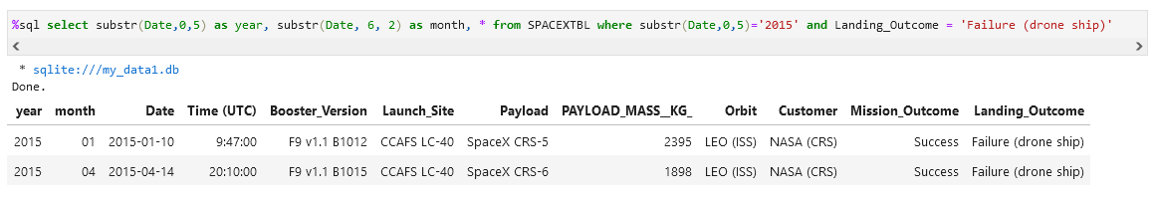
2015 Launch Records
A list of the failed landing outcomes on drone ships, their booster versions, and launch site names for in year 2015 is presented
The ‘substr’ function was used to extract the year and month from the date field for presentation and comparison

Slide 39
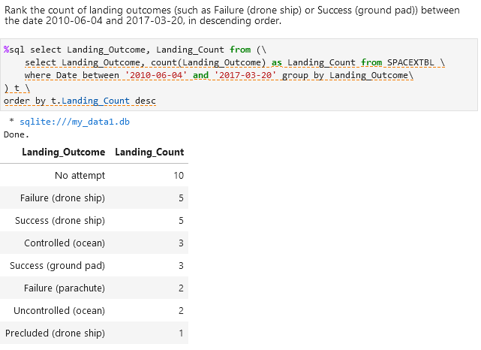
Rank Landing Outcomes Between 2010-06-04 and 2017-03-20
A rank of the count of landing outcomes between the date 2010-06-04 and 2017-03-20, in descending order is presented
A grouped subquery is used to calculate the count of each Landing Outcome
The outer query is used to sort the summarized subquery in descending order

Slide 40

Section 3

Slide 41
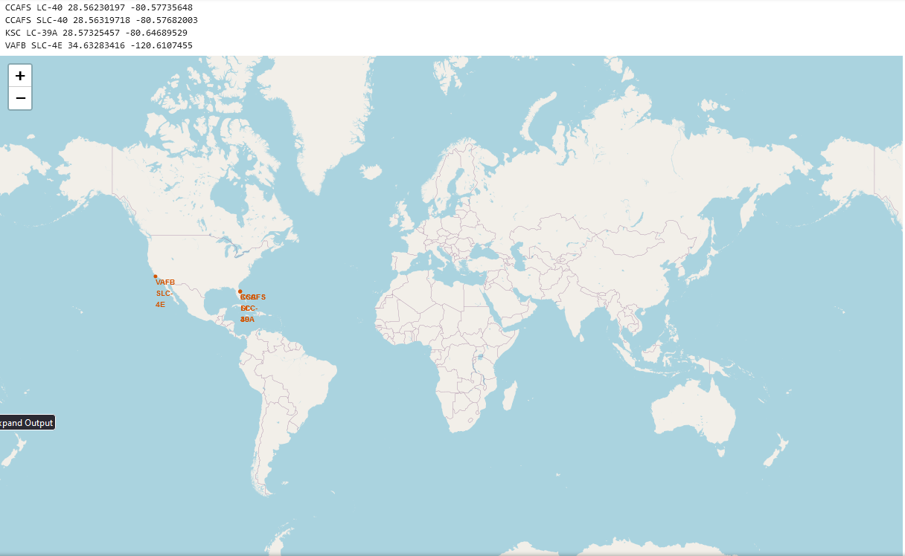
Global Map of SpaceX Launch Sites
SpaceX uses 4 launch sites indicated here on a global map
All are in the USA
All are located near coastlines
All are relatively near to the equator

Slide 42
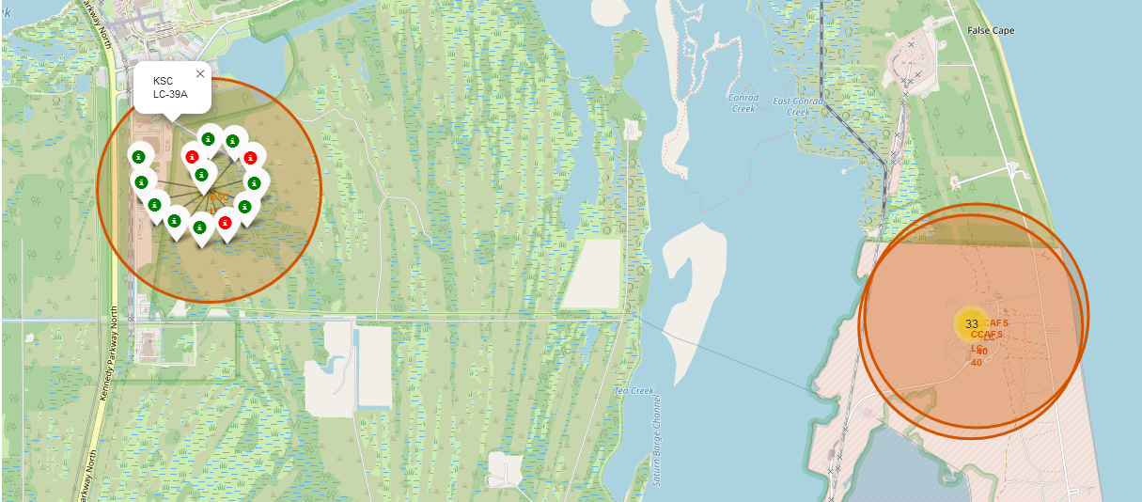
Launch site with color coded launch attempt markers
Detailed view of the Kennedy Space Center (KSC LC-39A) launches (left)
Each launch attempt has a marker, colored green for successful first stage recovery and red for failed first stage recovery
Nearby CCAFS LC-40 and CCAFS SLC-40 launch sites are also visible (right)

Slide 43
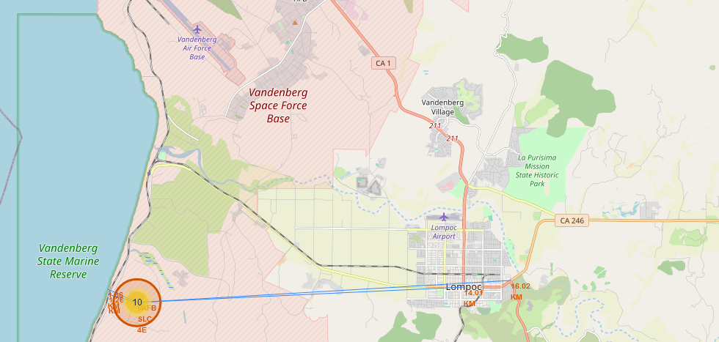
Launch site with proximities to selected features
Detailed view of Vandenberg Airforce Base (VAFB SLC-4E) launch site
Lines and distances are shown to nearby points of interest: the coastline, nearest rail line, nearest city and nearest highway

Slide 44

Section 4

Slide 45
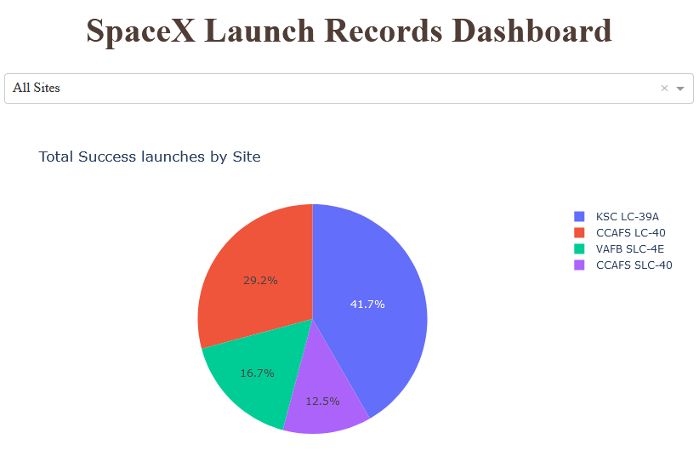
Dashboard: Total Successful launches by Site
Dashboard screenshot showing a pie chart of launch percentages by launch site where the first stage was successfully recovered
Dashboard provides a drop-down to select the launch site (All Sites selected).
KSC LC-39A has the greatest percentage of launches with successful first stage recoveries

Slide 46
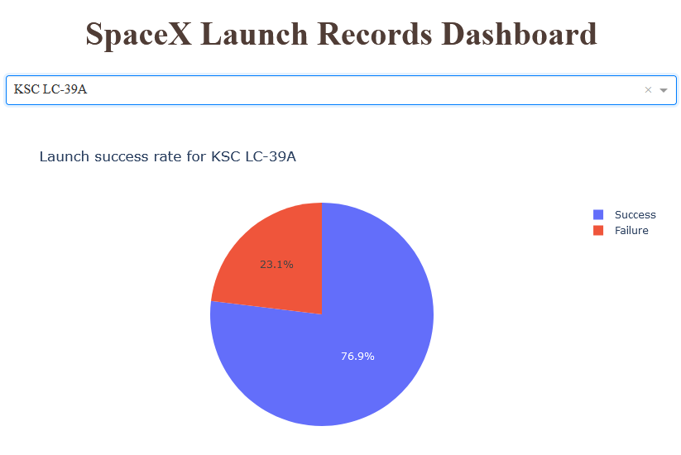
Dashboard: Launch success rate for KSC LC-39A
Dashboard screenshot showing the site with the highest first stage recovery success rate (KSC LC-39A)
KSC LC-39A achieved a 76.9% first stage recovery success rate

Slide 47
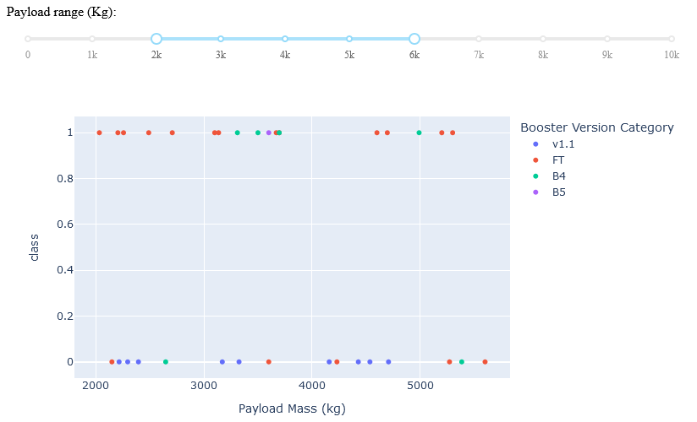
Dashboard: Success rate per Payload mass by Booster Version
Screenshot showing success(1)/failure(0) class of first stage recovery for all launch sites
The range slider has been used to restrict the chart to launches with a payload mass between 2,000 kg and 6,000 kg
The scatter markers are colored by the Booster Version Category
The “FT” version of the booster has had the largest percentage of successful recoveries within this payload range

Slide 48

Section 5

Slide 49
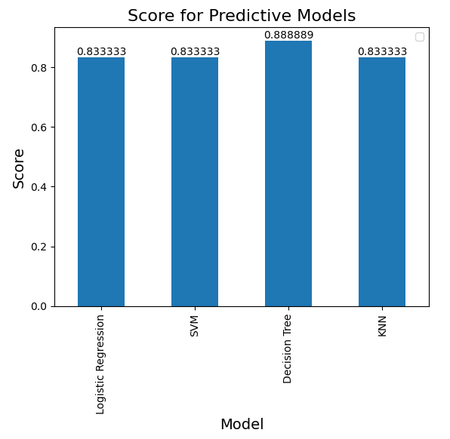
Classification Accuracy
A bar chart showing the score for each model after training based on the ‘test’ data set is presented
The Decision Tree was found to have the highest score on the test data

Slide 50
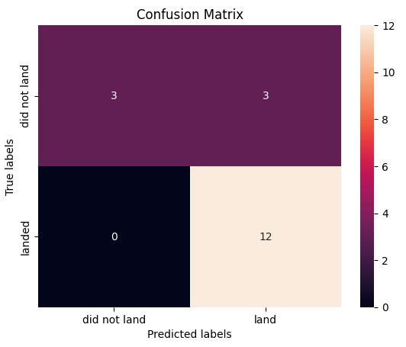
Confusion Matrix
A confusion matrix for the Decision Tree model is presented
The model correctly predicted all successful landings
The model correctly predicted half of the unsuccessful landings

Slide 51
Conclusions
We have shown that:
Landing sites should be place near coastlines and the equator
Kennedy Space Center (KSC LC-39A) launch site offers the highest chance of a successful first stage recovery
The highest chance of a first stage recovery success are for ES-L1, GEO, HEO and SSO orbits
Success rates increase with the flight number (time/experience)

Slide 52
Appendix
All analyzed data, Python code, SQL data and Jupyter notebooks used throughout this analysis are available in the repository at:
https://github.com/technobok/ibm_data_science_professional_certificate/tree/main/applied_datascience_capstone(10)

Slide 53


